Slide 1
An experimental scale-model study of a bidirectional flow control culvert in the Chequessett Neck Road dike at the Herring River Estuary
Claire Wang
Environmental Engineering Undergraduate ’27

Slide 2
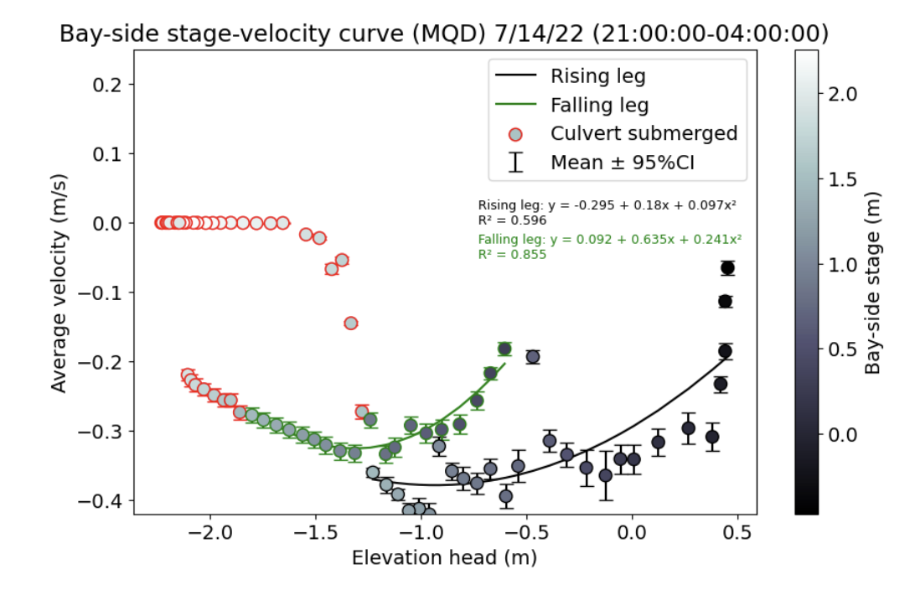
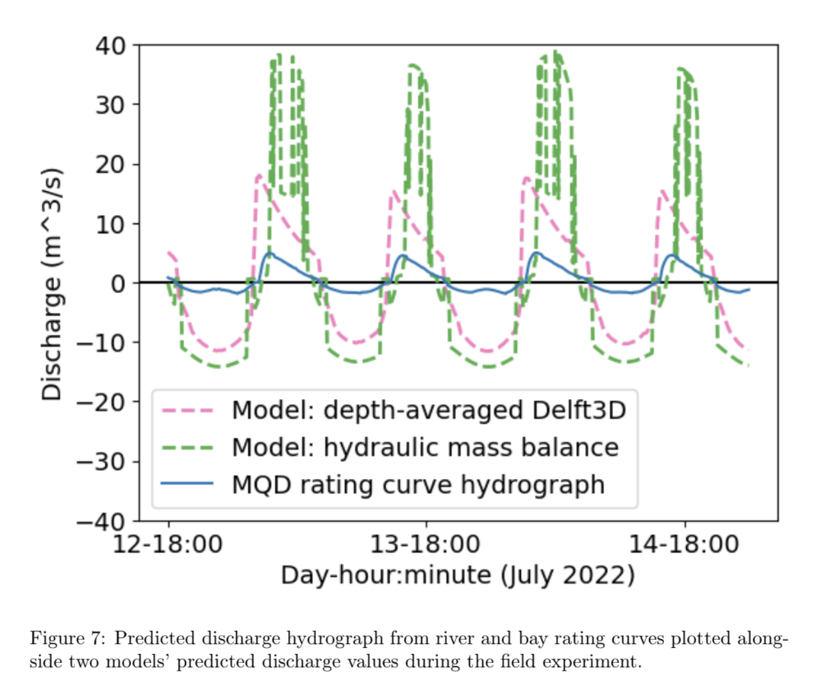
Background and motivation

Slide 3
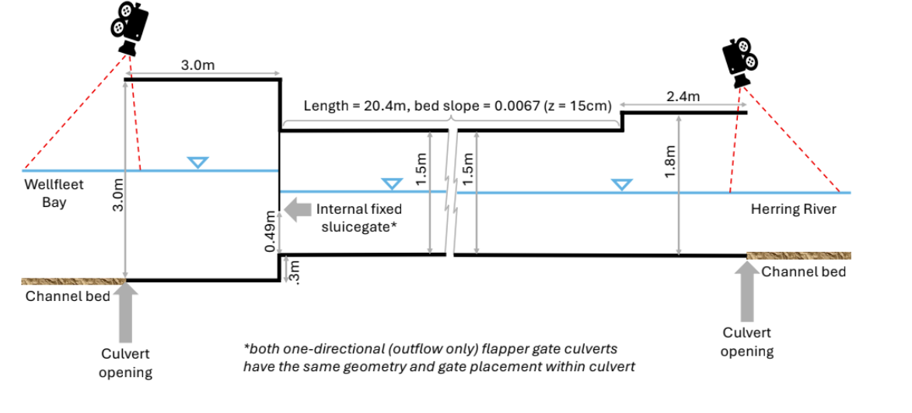
Bidirectional culvert

Slide 4
Research questions
How does the scale model in the lab compare to field measurements and existing models?
What is the head loss generated by the hydraulic jump in the culvert?
What is causing the hysteresis seen in the experimental stage-velocity curves?

Slide 5
Experimental setup
Using open channel flow flume as a scale model
Scale factor - 3.05:1
Sensors
Ultrasonic sensor to measure water height
Bay side
ADV to measure water velocity
Inside the culvert
River side
Fixed sluicegate
Water is pumped in
Fixed weir
Water flows out
Head tank
Supercritical region
Hydraulic jump
Subcritical region
Tailwater tank

Slide 6
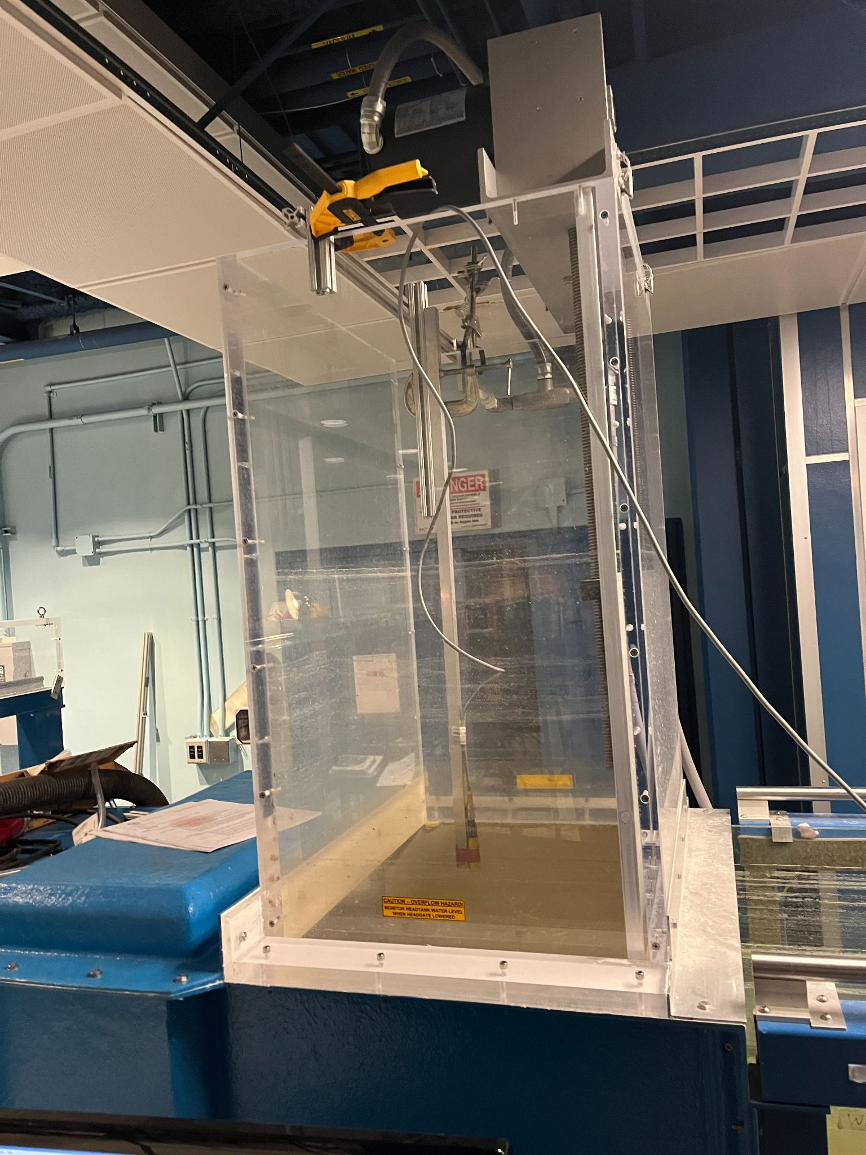
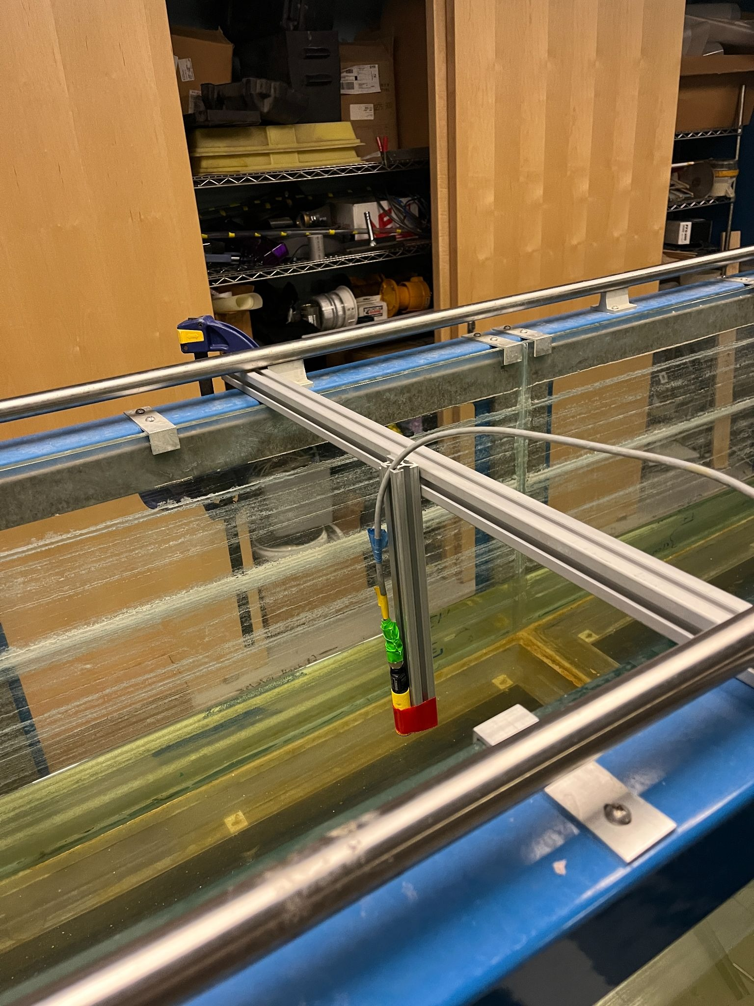
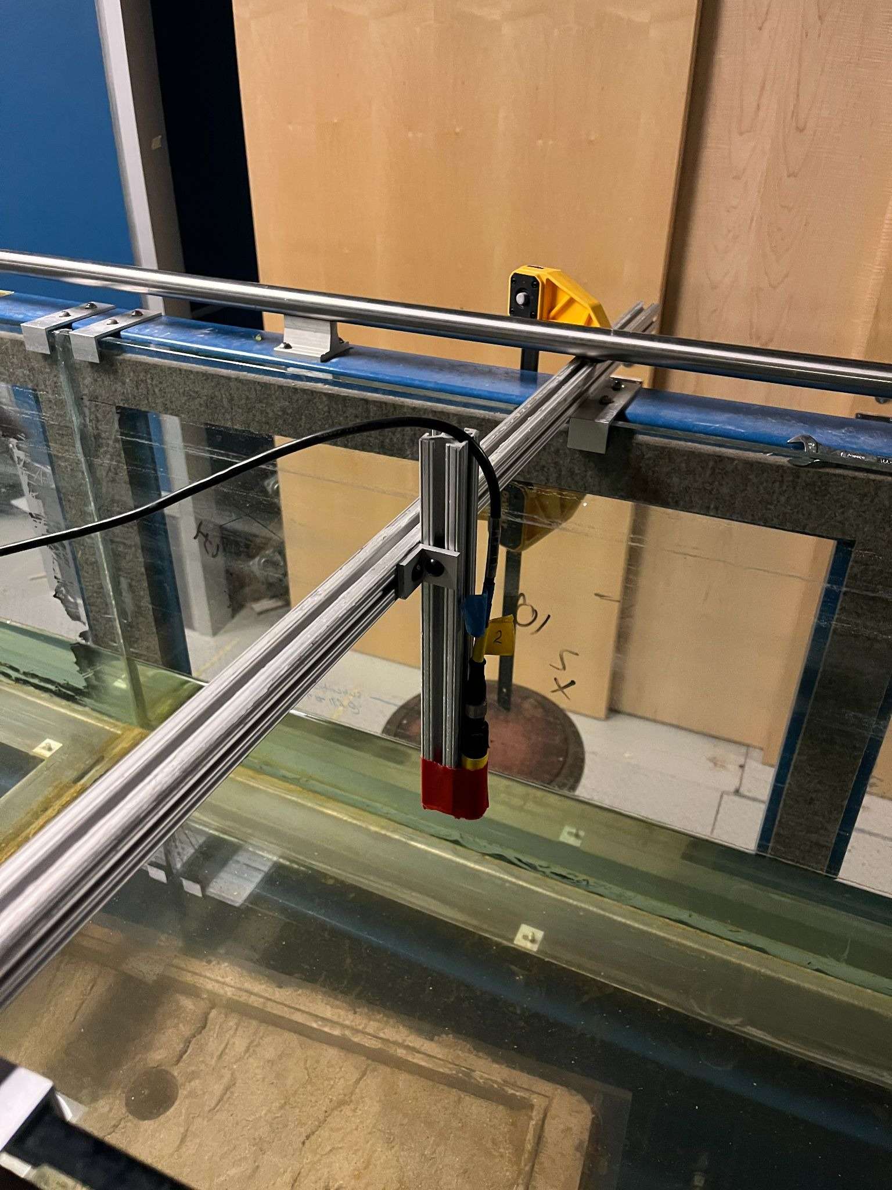
Water height sensors
Head tank
Supercritical
Subcritical

Slide 7
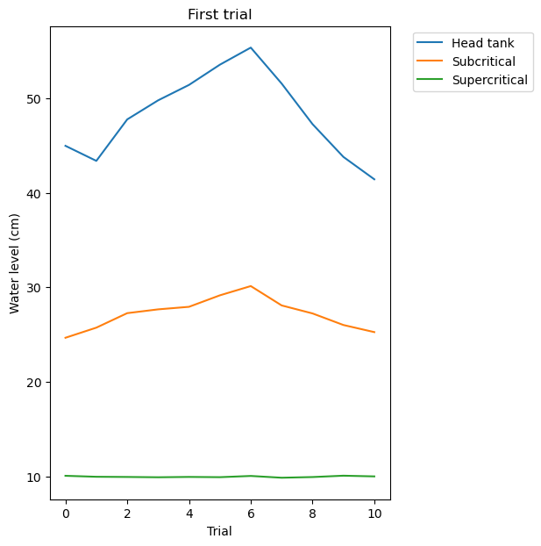
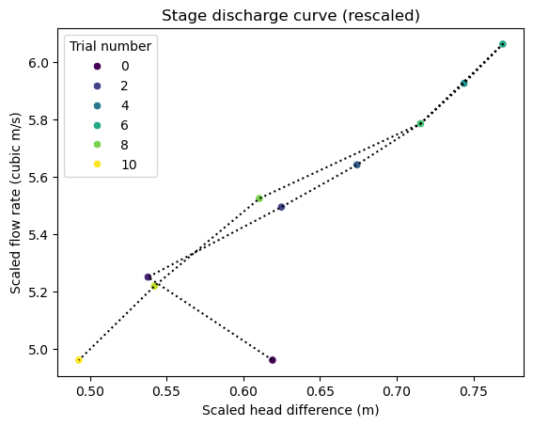
First trial – how does discharge change with changing hydraulic head?
Note: no hysteresis was observed!
Not sure why trial 1 is not consistent with other data points

Slide 8
Second trial – observe how discharge changes with changing head difference

Slide 9
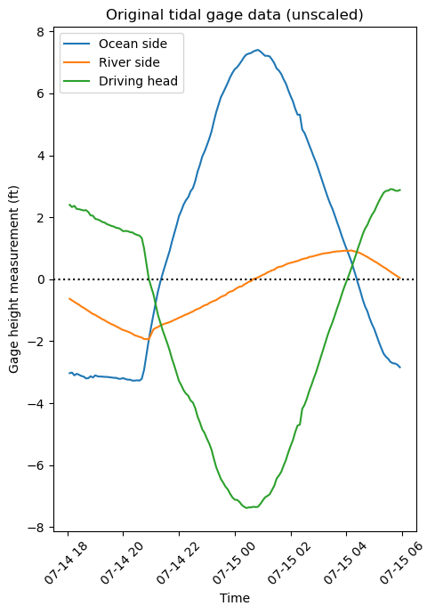
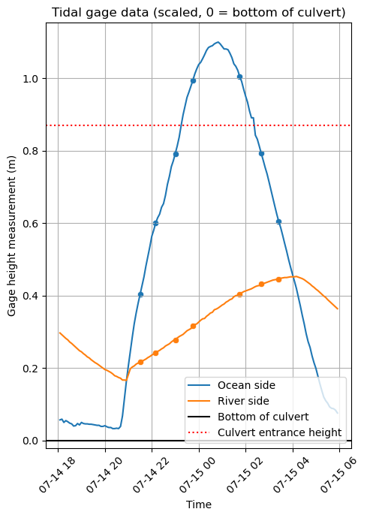
Scaled hydrograph
3.05:1
scale factor

Slide 10
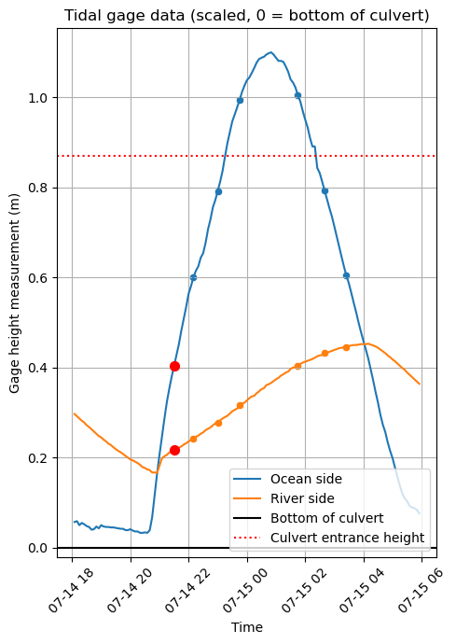
In progress: matching gage hydrograph
Rescaled discharge: 4.17 m³/s
Rescaled head difference: 0.56 m
How does this compare with the field measurements and model predictions?

